Slide 1
?
2 yrs
2 yrs
MD
PhD
MD

Slide 2
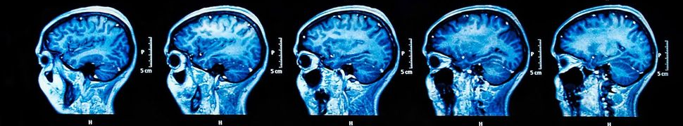


Long COVID: Virus in the Brain? Jason Yeung ( @jayeung12 ) Dr. Pei-Yong Shi Lab MD-PhD Seminar Series, 10th February, 2023 UTMB, Galveston

Slide 3
Overview
A. General Background
B. SARS-CoV-2 in the Brain
C. Experiments
D. Takeaway

Slide 4
The Clinical Spectrum of Viral CNS Infections is Broad
Symptom | Virus
Encephalitis/meningitis | Many, many viruses
Paralysis | Enterovirus D68, Poliovirus
Behavioral change | Bornavirus, Nipah virus, Rabies virus
Cognitive/memory deficits | HIV, WNV, SARS, SARS-CoV-2
Notes:
Many viruses, both established or emerging, can cause issues with the brain. The outcomes of viral infections of the brain have a wide range of clinical severity and manifestations. While some are very subtle, others are life threatening. Some symptoms happen quickly after infection while some take years to manifest. For example, viral infections of the brain have also been associated with neurodegenerative disorders such as Alzheimer’s and play a key role in several theories of disease pathogenesis.
This table shows just a sampling of possible outcomes and associated viruses.
I would like to point out a particularly dramatic association – behavioral change. This association demonstrates that viruses can fundamentally change the personality of an individual, what we often consider the essence of an individual, and can do this in a transmissible manner.

Slide 5
Viruses can alter your mind
Notes:
Naturally, this is a major biodefense issue. Efforts by governments to influence populations by direct biological means have largely failed like the US government’s MK Ultra program, viruses demonstrate that this is theoretically achievable with more and more advanced technology.
The fine-tuning of emergent properties of the brain – altering memory, changing personality and cognition will occur through improvements in 4 fields -
neuroscience, cell-specific targeting, controllable gene expression, and engineered viral vectors.

Slide 6
How does SARS-CoV-2 cause damage in the brain?
Notes:
Let’s now turn to the current pandemic. Dr. Shi has connected me with a husband and wife team who use brain organoids to study neurodevelopmental disorders

Slide 7
NeuroCOVID or Post COVID or Long COVID or PASC
NeuroCOVID - Neurologic or psychiatric symptoms during SARS-CoV-2 infection. Also includes headache, loss of taste/smell.

Slide 8

NeuroCOVID or Post COVID or Long COVID or PASC
Post COVID-19 condition / Long COVID / Post-acute sequelae of SARS CoV-2 infection (PASC)
occurs in individuals with a history of probable or confirmed SARS CoV-2 infection,
usually 3 months from the onset of [symptomatic] COVID-19
and that last for at least 2 months and cannot be explained by an alternative diagnosis.
– From

Slide 9
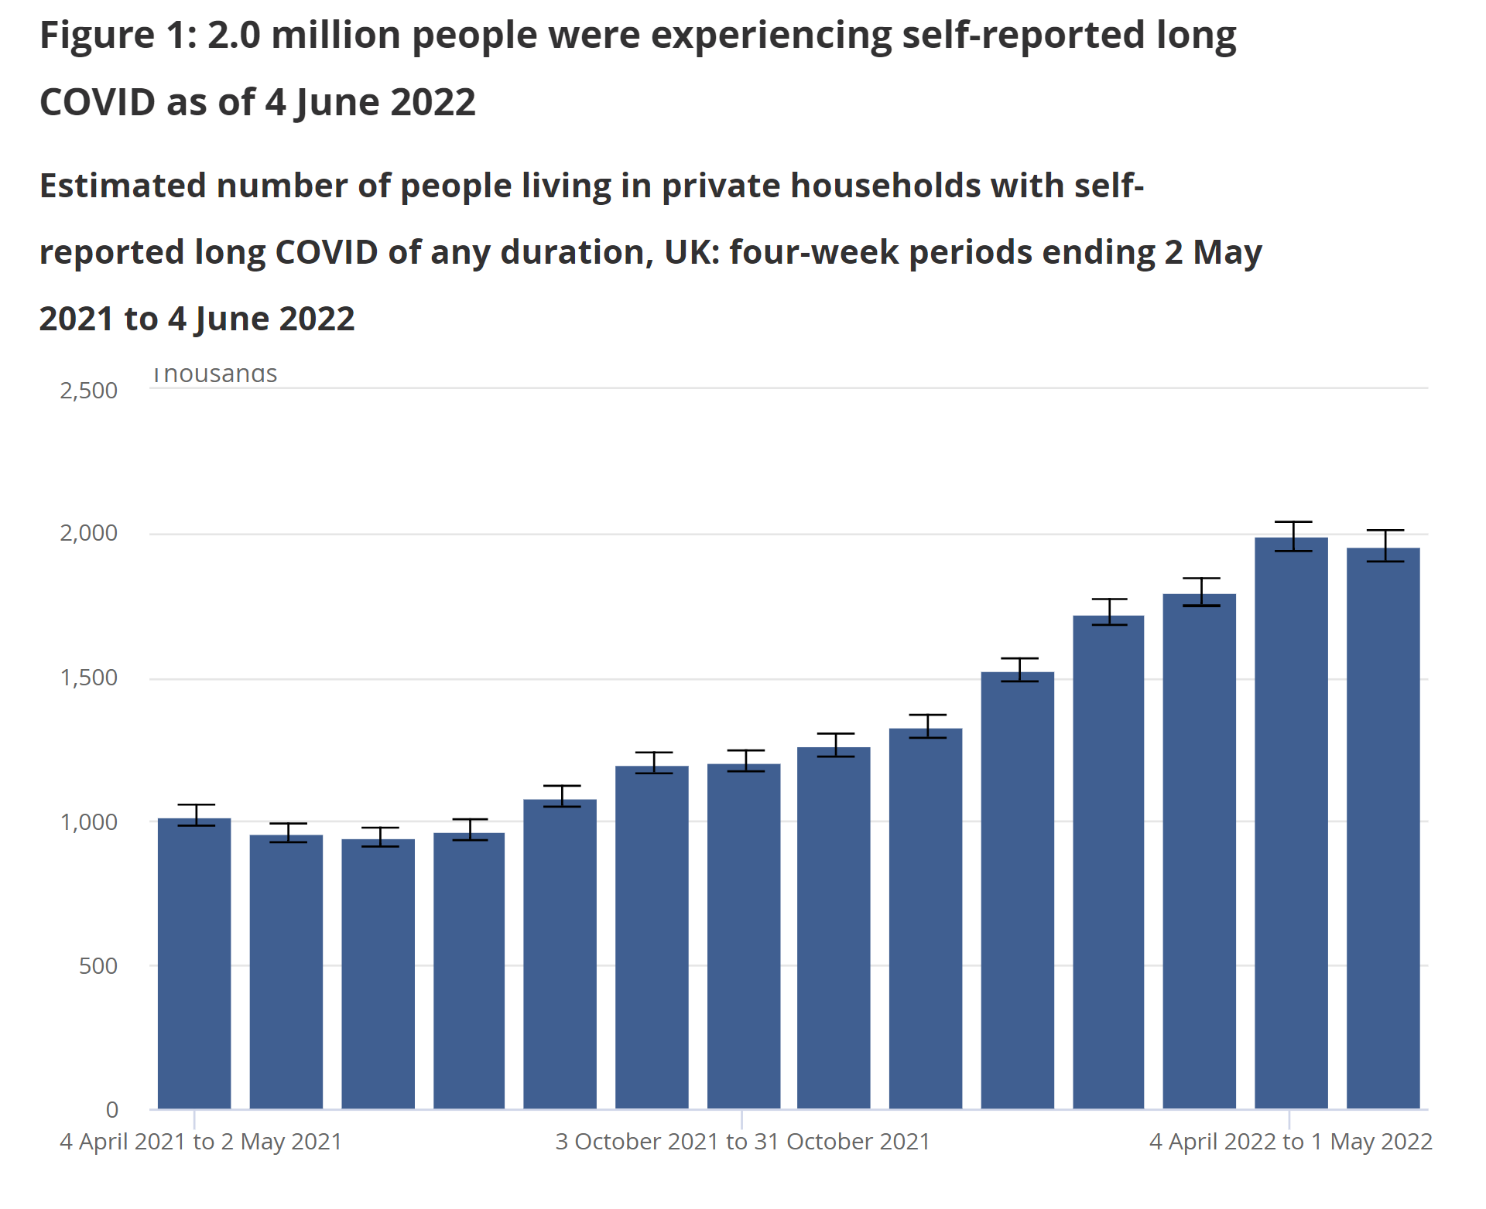

United Kingdom

Slide 10
~2.0 million people in the UK (3.1% of the population) were experiencing self-reported long COVID
Long COVID affects the day-to-day activities of 1.4 million people
409,000 (21%) - "limited a lot".
- From (UK Government)

Slide 11

Tanysha Dissanayake Professional Tennis Player
"It's basically been downhill ever since," the 21-year-old said. "For most of this year, I've been completely bedbound. Just to speak to you today, I didn't do anything the whole of the morning, didn't do much yesterday. One of my friends came over the other day. I had to rest for five days after that."

Slide 12
Therapeutic Options?
Paxlovid | Clopidogrel + Apixaban + Aspirin
Vagus Nerve Stimulation | Guanfacine
Maraviroc | N-acetylcysteine
Pravastatin | Efgartigimod
Colchicine | Lithium
Coenzyme Q10 | Apheresis
Famotidine | Autologous Stem Cells

Slide 13
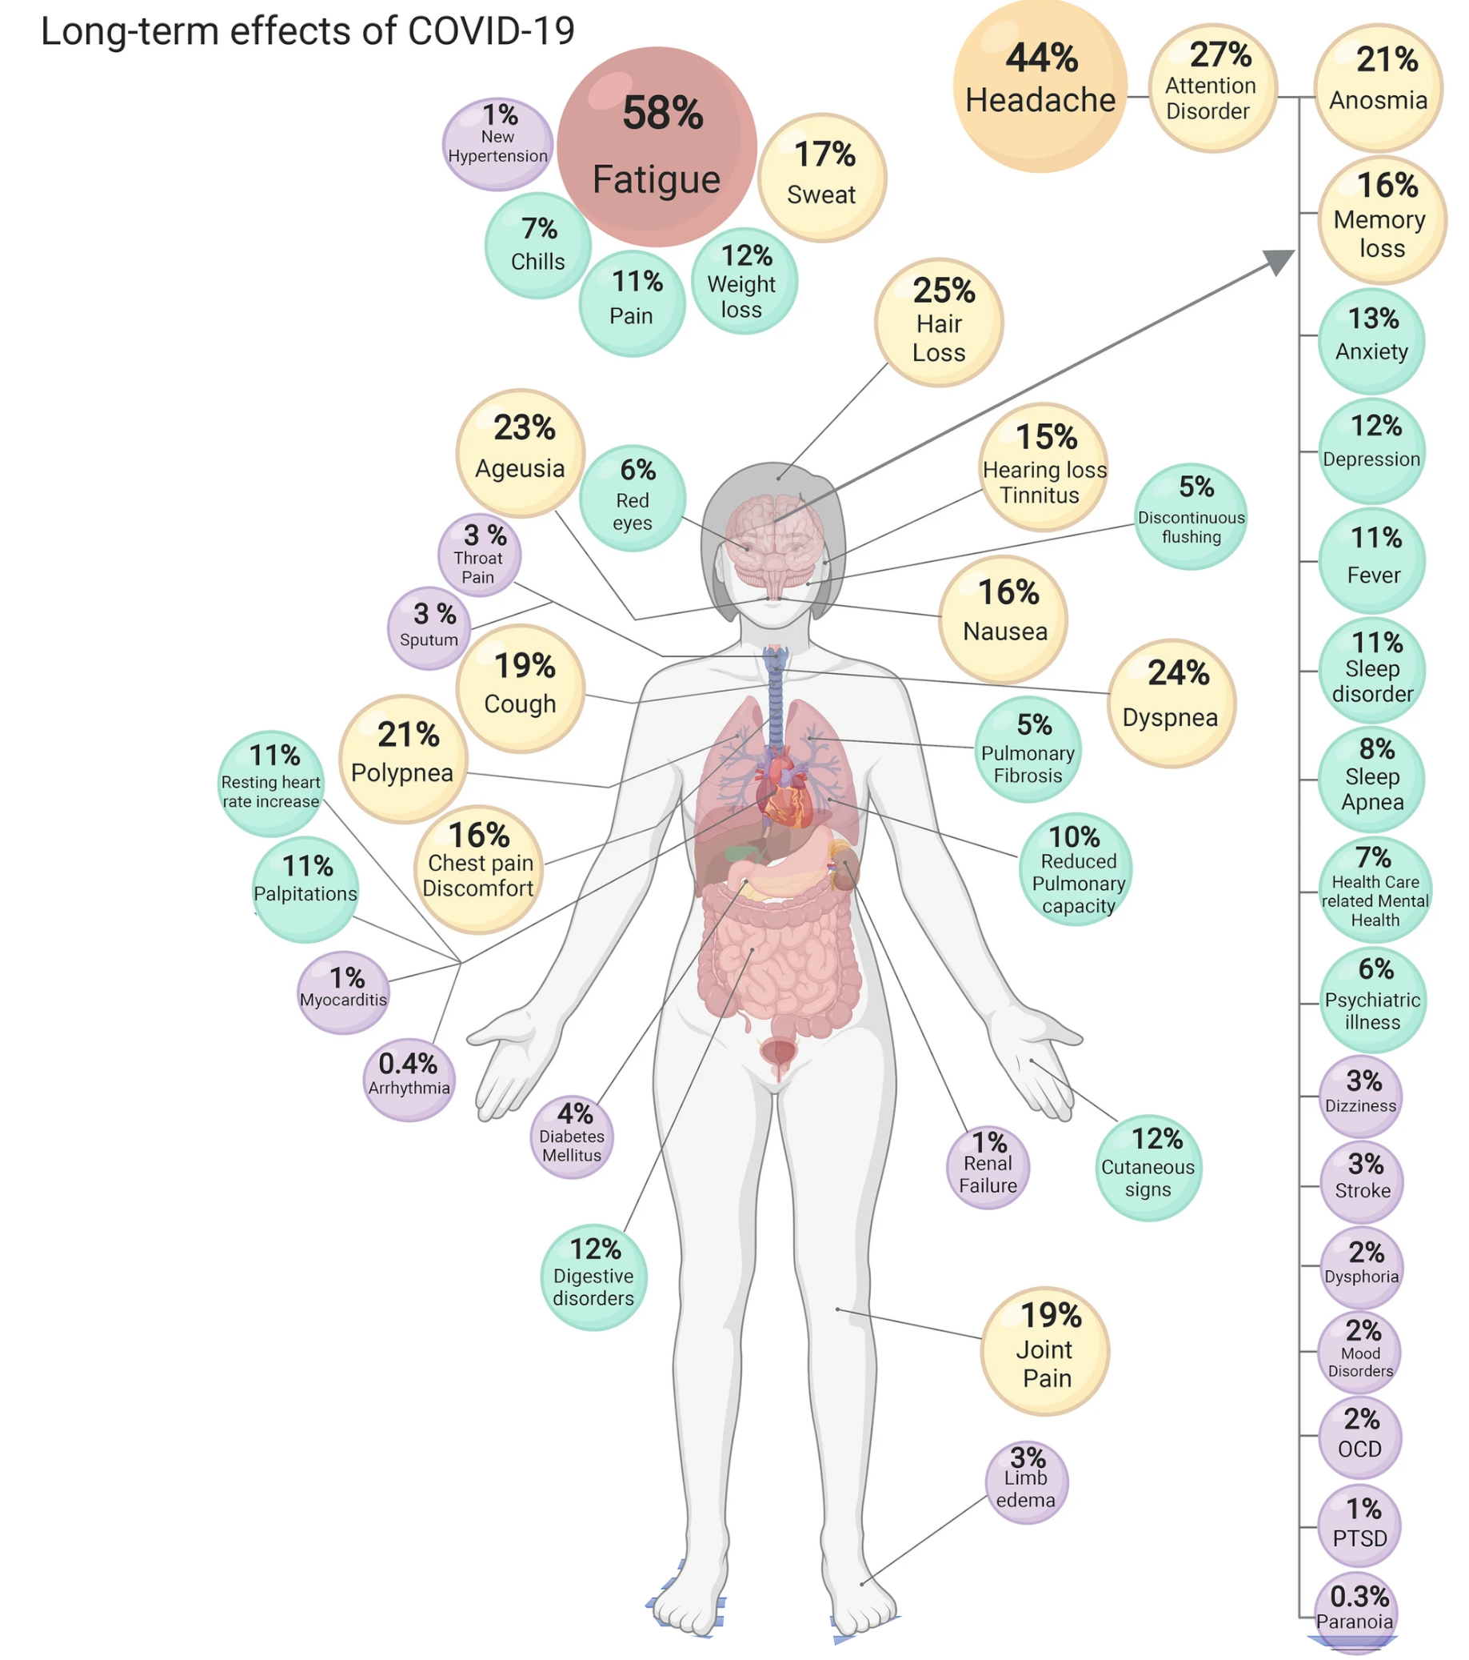
Developing reliable diagnostics?
Notes:
A lung damage long covid and a brain affecting long covid
Mention difficulty of developing diagnostics

Slide 14
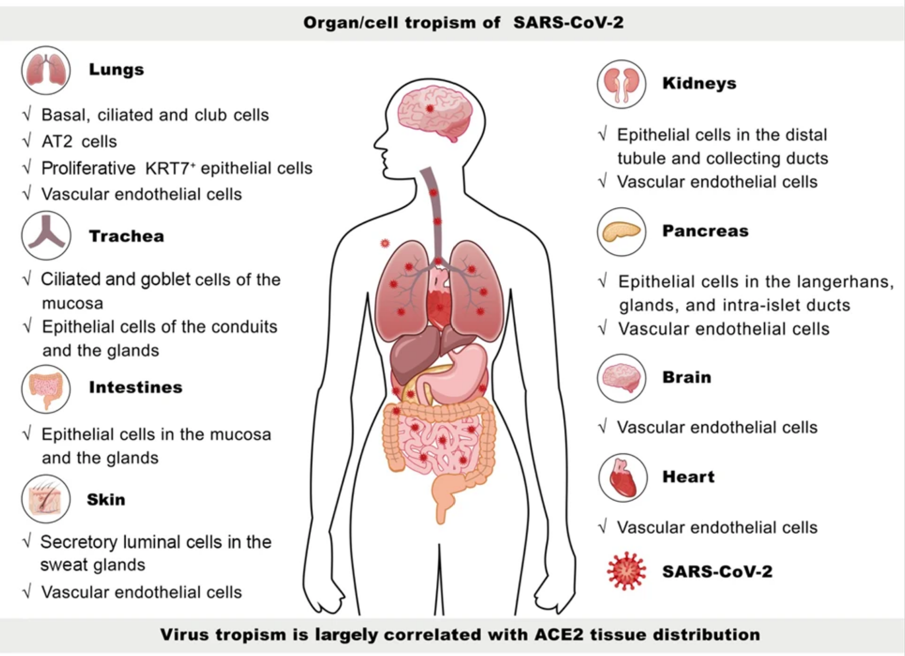
- Later slides -
SARS-CoV-2 cell tropism and multiorgan infection. Liu et al 2021
Notes:
Many viruses, both established or emerging, can cause issues with the brain. The outcomes of viral infections of the brain have a wide range of clinical severity and manifestations. While some are very subtle, others are life threatening. Some symptoms happen quickly after infection while some take years to manifest. For example, viral infections of the brain have also been associated with neurodegenerative disorders such as Alzheimer’s and play a key role in several theories of disease pathogenesis.
This table shows just a sampling of possible outcomes and associated viruses.
I would like to point out a particularly dramatic association – behavioral change. This association demonstrates that viruses can fundamentally change the personality of an individual, what we often consider the essence of an individual, and can do this in a transmissible manner.

Slide 15
Evidence for SARS-CoV-2 Neuro-invasion
Other coronaviruses can enter the brain
Entry receptors are present on some CNS cells
Intra-thecal antibodies
Detection in CSF and brain (sometimes)
Strength of Evidence

Slide 16
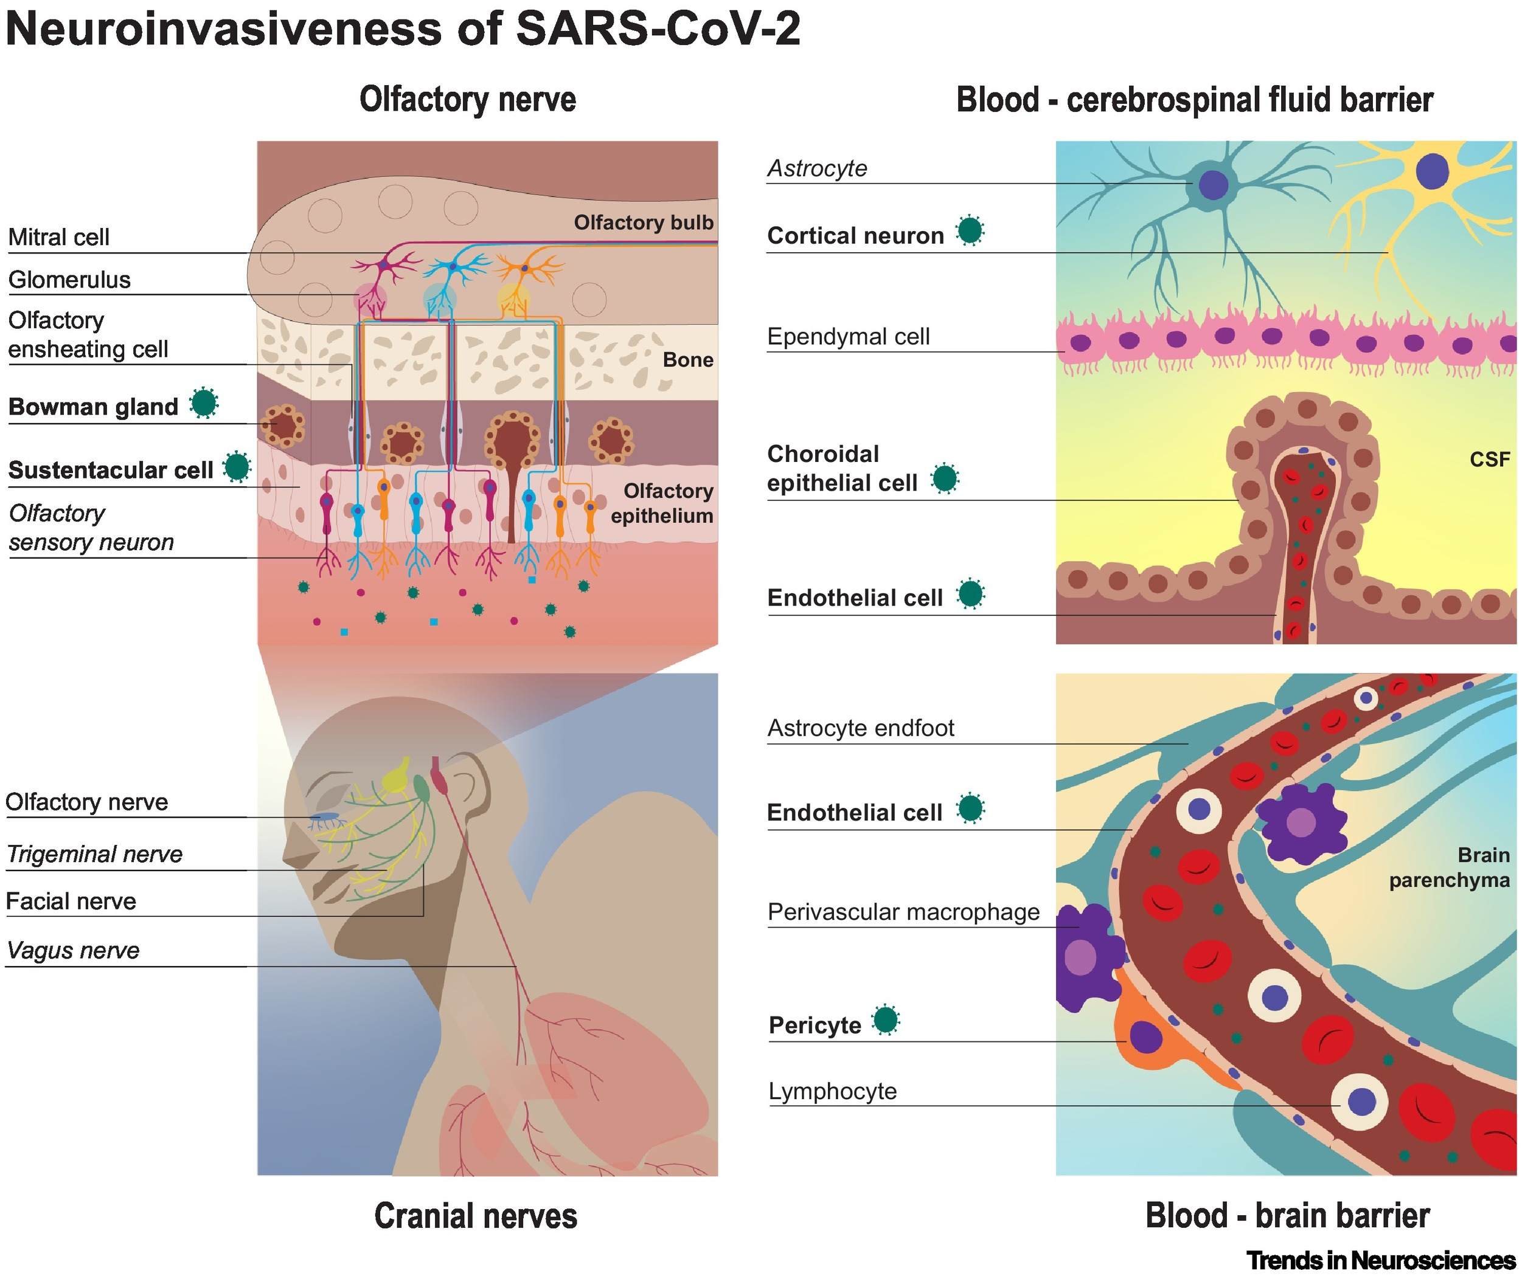
The neuroinvasiveness, neurotropism, and neurovirulence of SARS-CoV-2. Bauer et al. 2021
Notes:
Early on in the pandemic, potential for brain involvement was identified in Wuhan. Past outbreaks with beta coronaviruses indicated that neurologic consequences might be possible with SARS-CoV-2 as well.
This spawned the medical entity known as NeuroCOVID with symptoms such as those listed here in this table.

Slide 17
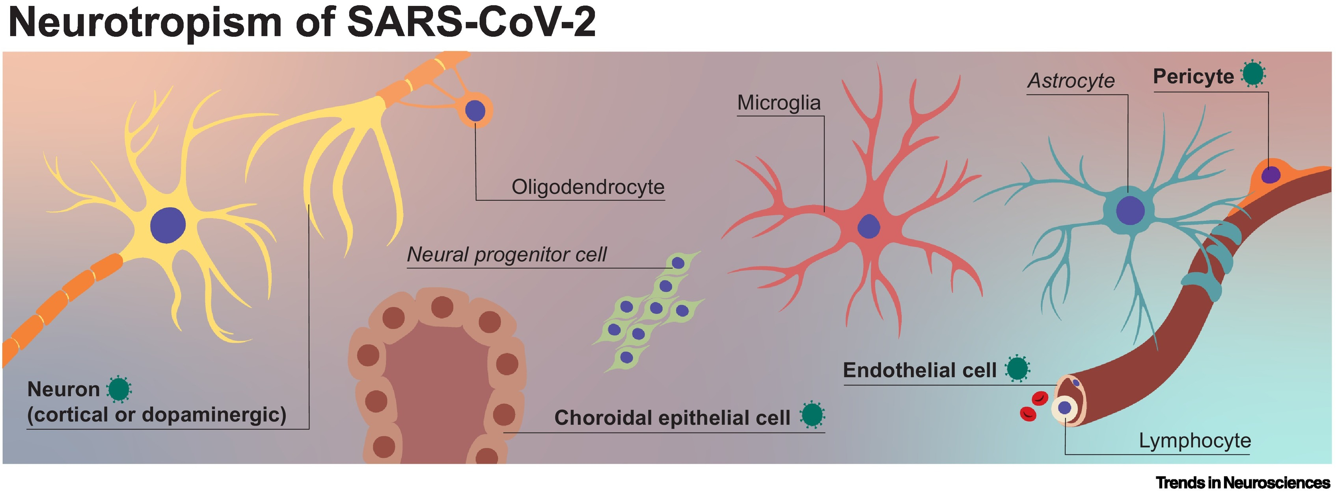
The neuroinvasiveness, neurotropism, and neurovirulence of SARS-CoV-2. Bauer et al. 2021
Notes:
Bolded are infected

Slide 18
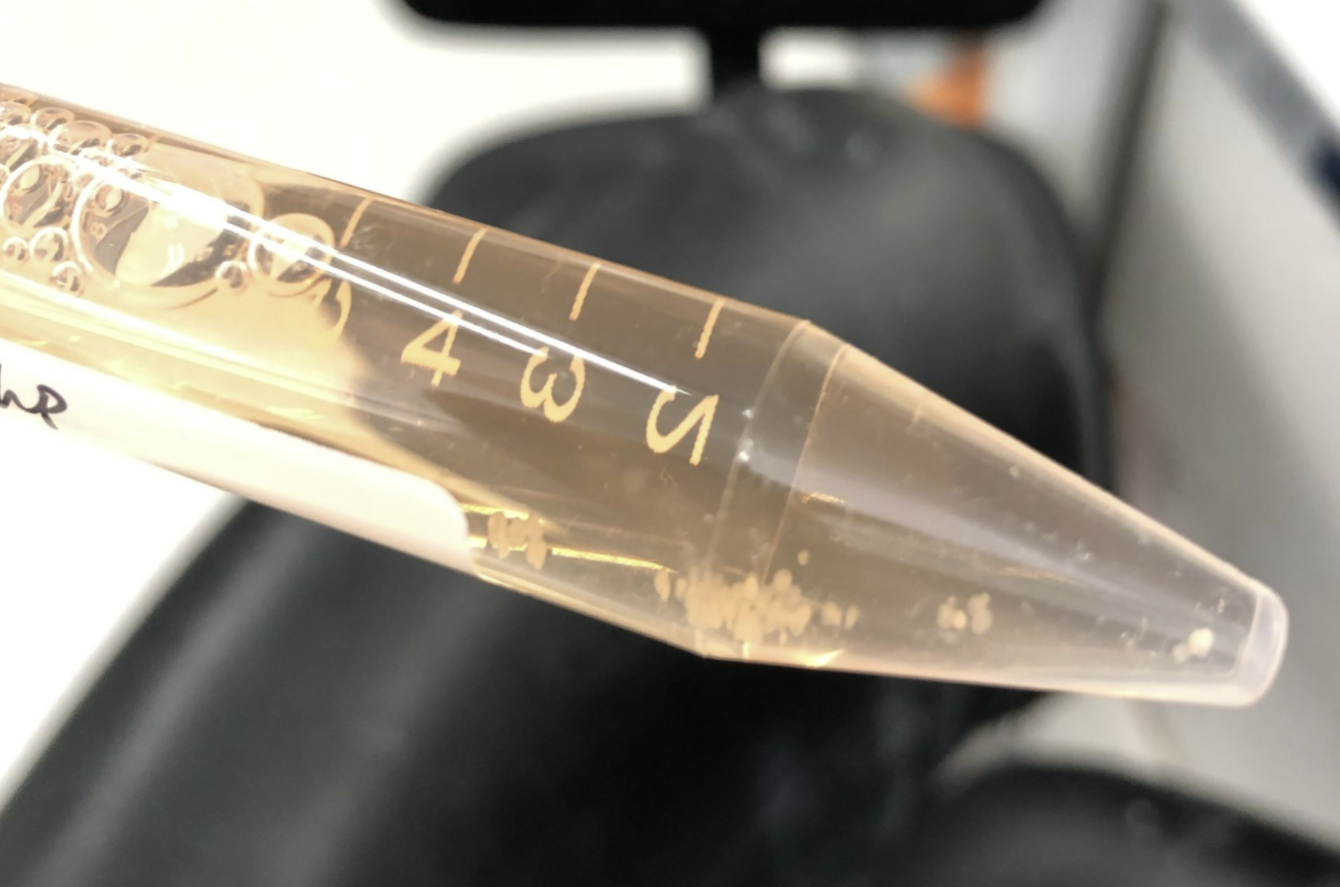
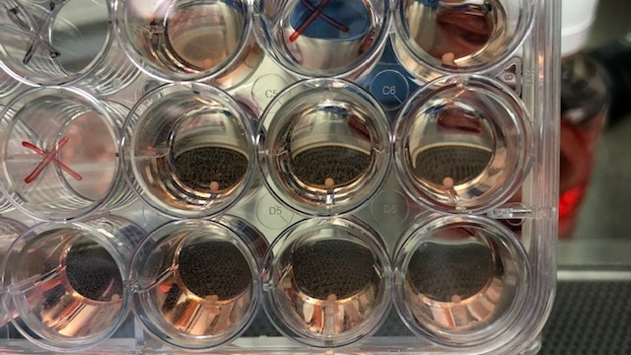
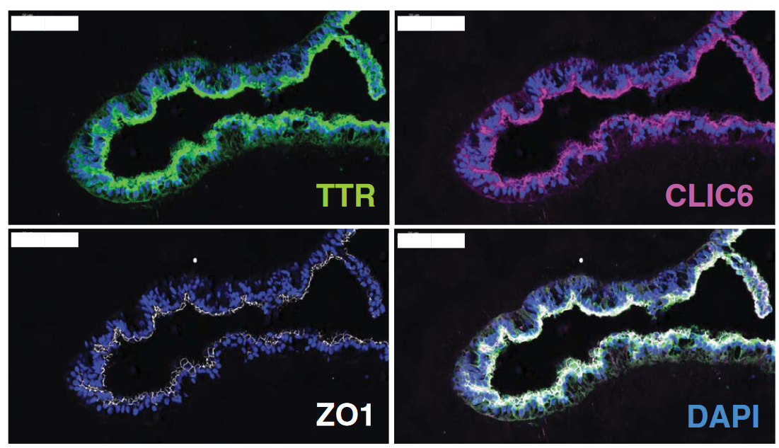
Autopsy and Organoids
Human CNS barrier-forming organoids with cerebrospinal fluid production. Pellegrini et al. 2020
Notes:
Here we focus on the use of organoids – a cell culture system that uses stem cells differentiated to various parts of the CNS.
These are organoids I took care of in a past lab I worked with where we did herpesvirus drug screens.
It works well in concert with animal models and autopsy studies, two other ways of studying brain infections. You can manipulate most aspects of the experimental setting and use authentic human cells. However, functional outputs like behavior are currently not studiable

Slide 19
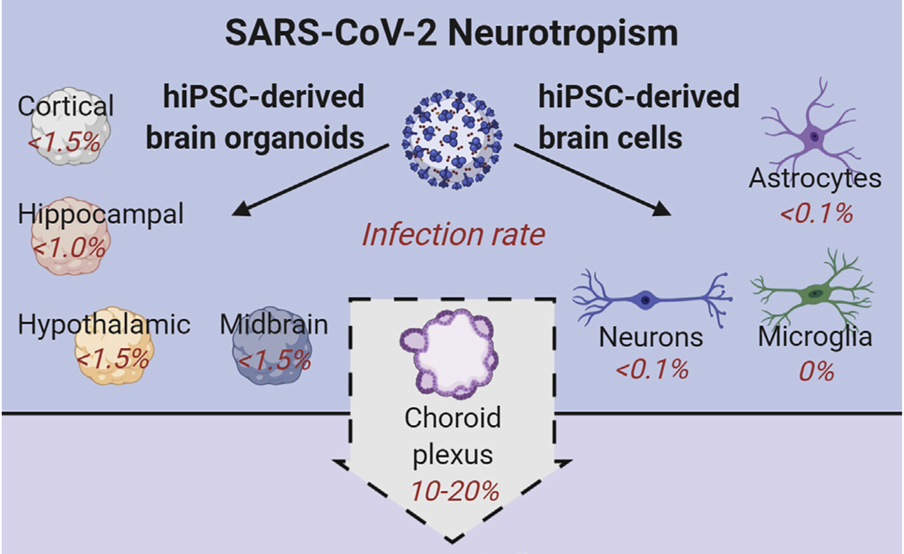
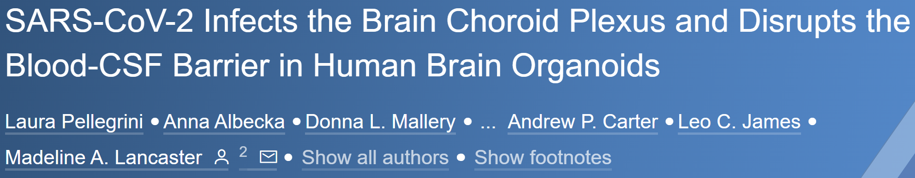
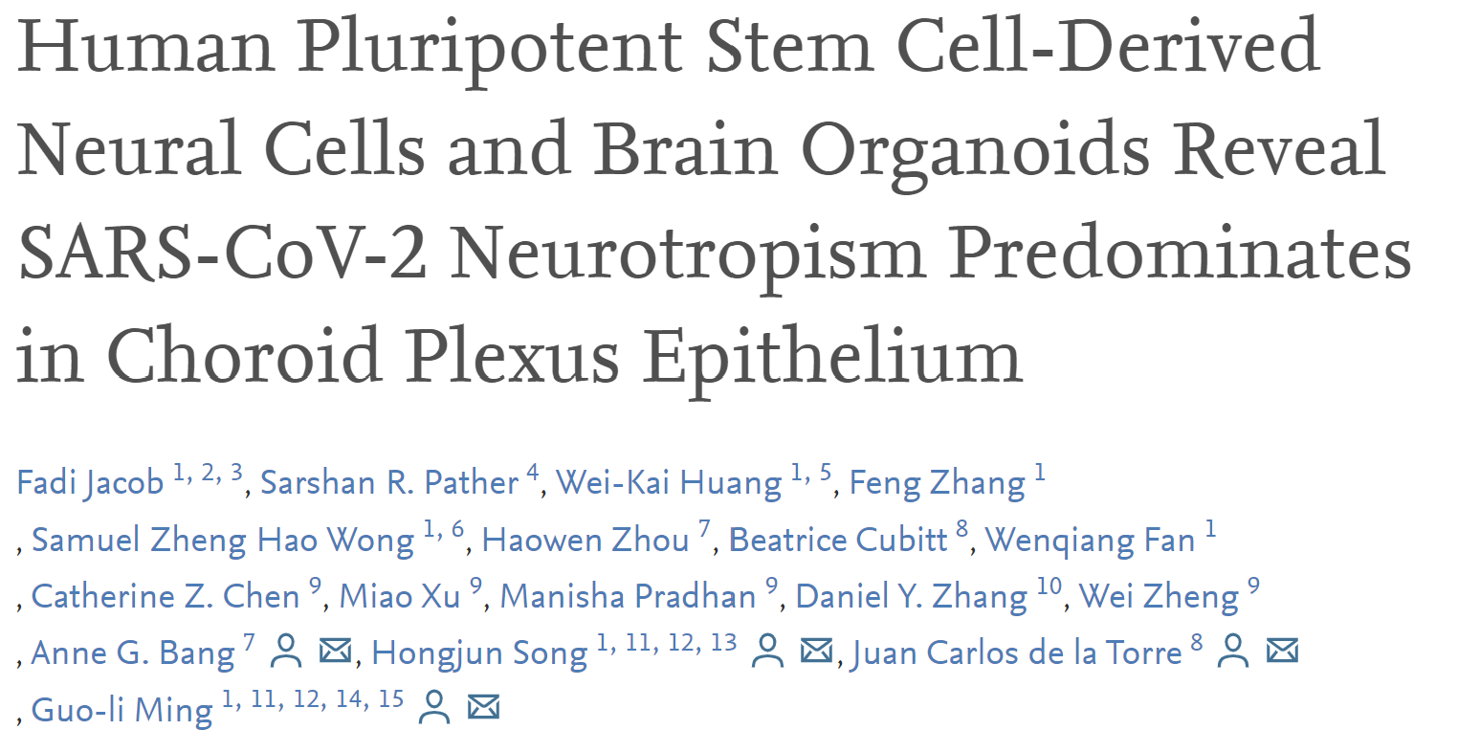
The neuroinvasiveness, neurotropism, and neurovirulence of SARS-CoV-2. Bauer et al. 2021
Notes:
Bolded are infected

Slide 20
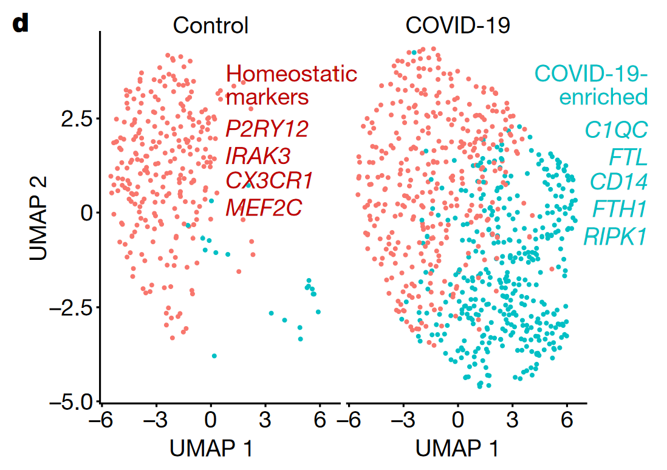
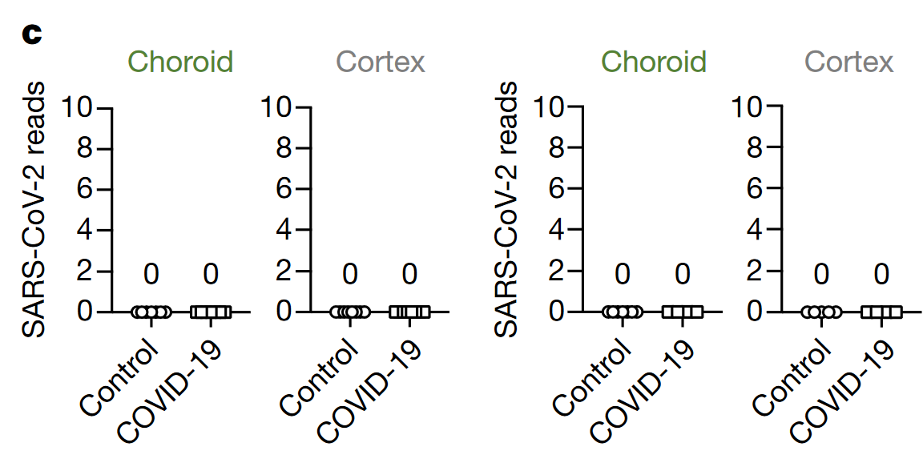
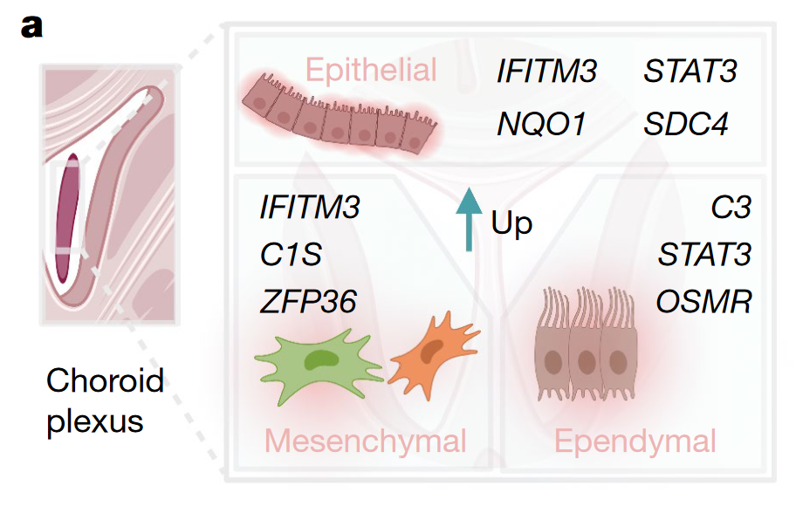
No virus detected in Choroid Plexus
BUT
Inflammatory signaling at Choroid Plexus and in Brain
Dysregulation of brain and choroid plexus cell types in severe COVID-19. Yang et al. 2021
Notes:
CSF in other studies only sometimes shows virus

Slide 21
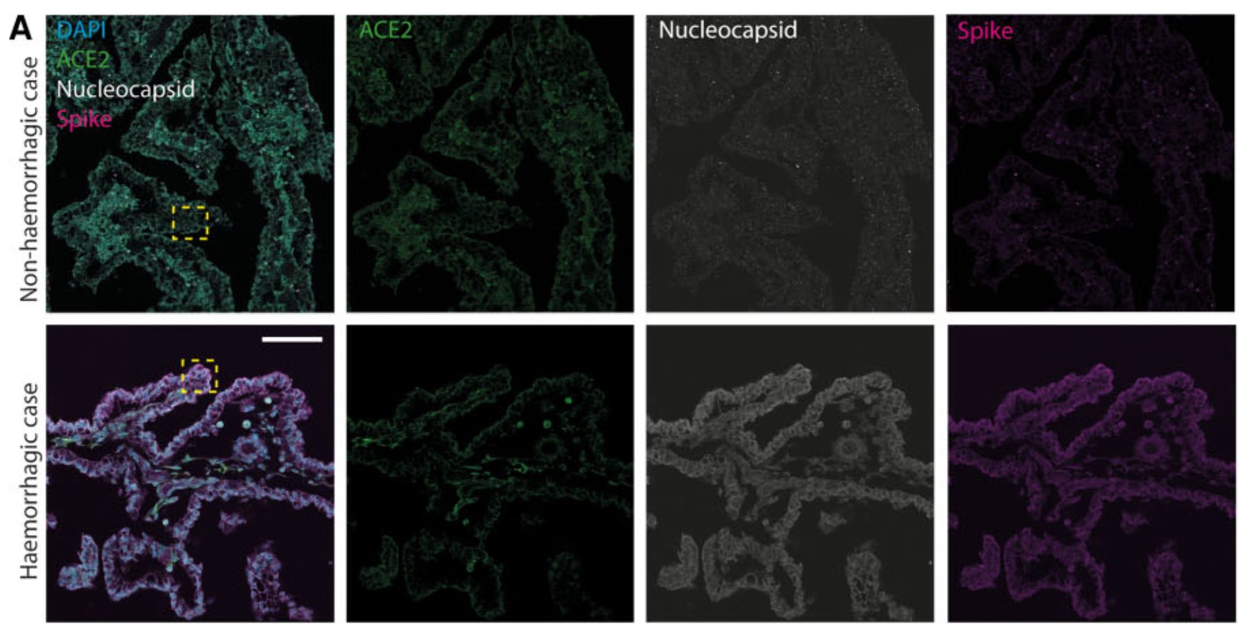
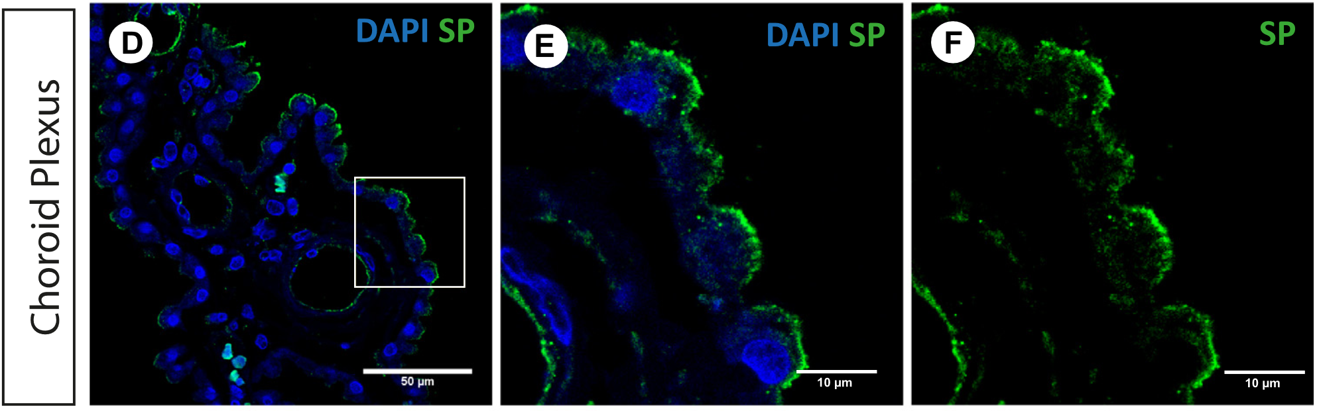
Fetus
Haemorrhage of human foetal cortex associated with SARS-CoV-2 infection. Massimo et al. 2022
Infant
SARS-CoV-2 infection of the central nervous system in a 14-month-old child: A case report of a complete autopsy. Gomes et al. 2022
Notes:
Only two autopsy reports

Slide 22



How does SARS-CoV-2 cause damage in the brain?
Dr. Pei-Yong Shi
Dr. Guo-li Ming
Dr. Hongjun Song
Notes:
Let’s now turn to the current pandemic. Dr. Shi has connected me with a husband and wife team who use brain organoids to study neurodevelopmental disorders

Slide 23
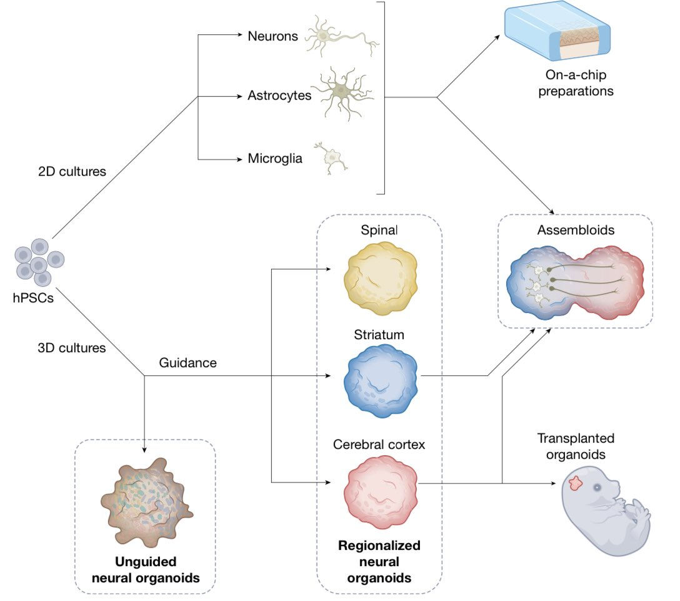
Assembloids
Choroid Plexus
Notes:
To model this, the Song and Ming Lab is shipping us assembloids where the choroid plexus is fused to brain cortex organoids.

Slide 24
How to study infection of the human brain?
Human CNS barrier-forming organoids with cerebrospinal fluid production. Pellegrini et al. 2020
Notes:
Here we focus on the use of organoids – a cell culture system that uses stem cells differentiated to various parts of the CNS.
These are organoids I took care of in a past lab I worked with where we did herpesvirus drug screens.
It works well in concert with animal models and autopsy studies, two other ways of studying brain infections. You can manipulate most aspects of the experimental setting and use authentic human cells. However, functional outputs like behavior are currently not studiable

Slide 25
Aims
A. Difference in infectivity for variants
How does % infection change with different SARS-CoV-2 variants?
B. Persistence of virus and inflammation
How long do we observe mNeonGreen signal in organoids?
How long do we detect production of inflammatory molecules?
C. Changes in brain cell expression profile
How does infection of the choroid plexus impact transcription in other cells in the brain?
D. Viral adaptation to infection of brain cells
What viral genomic changes can we find through sequencing after growth in brain cells?

Slide 26
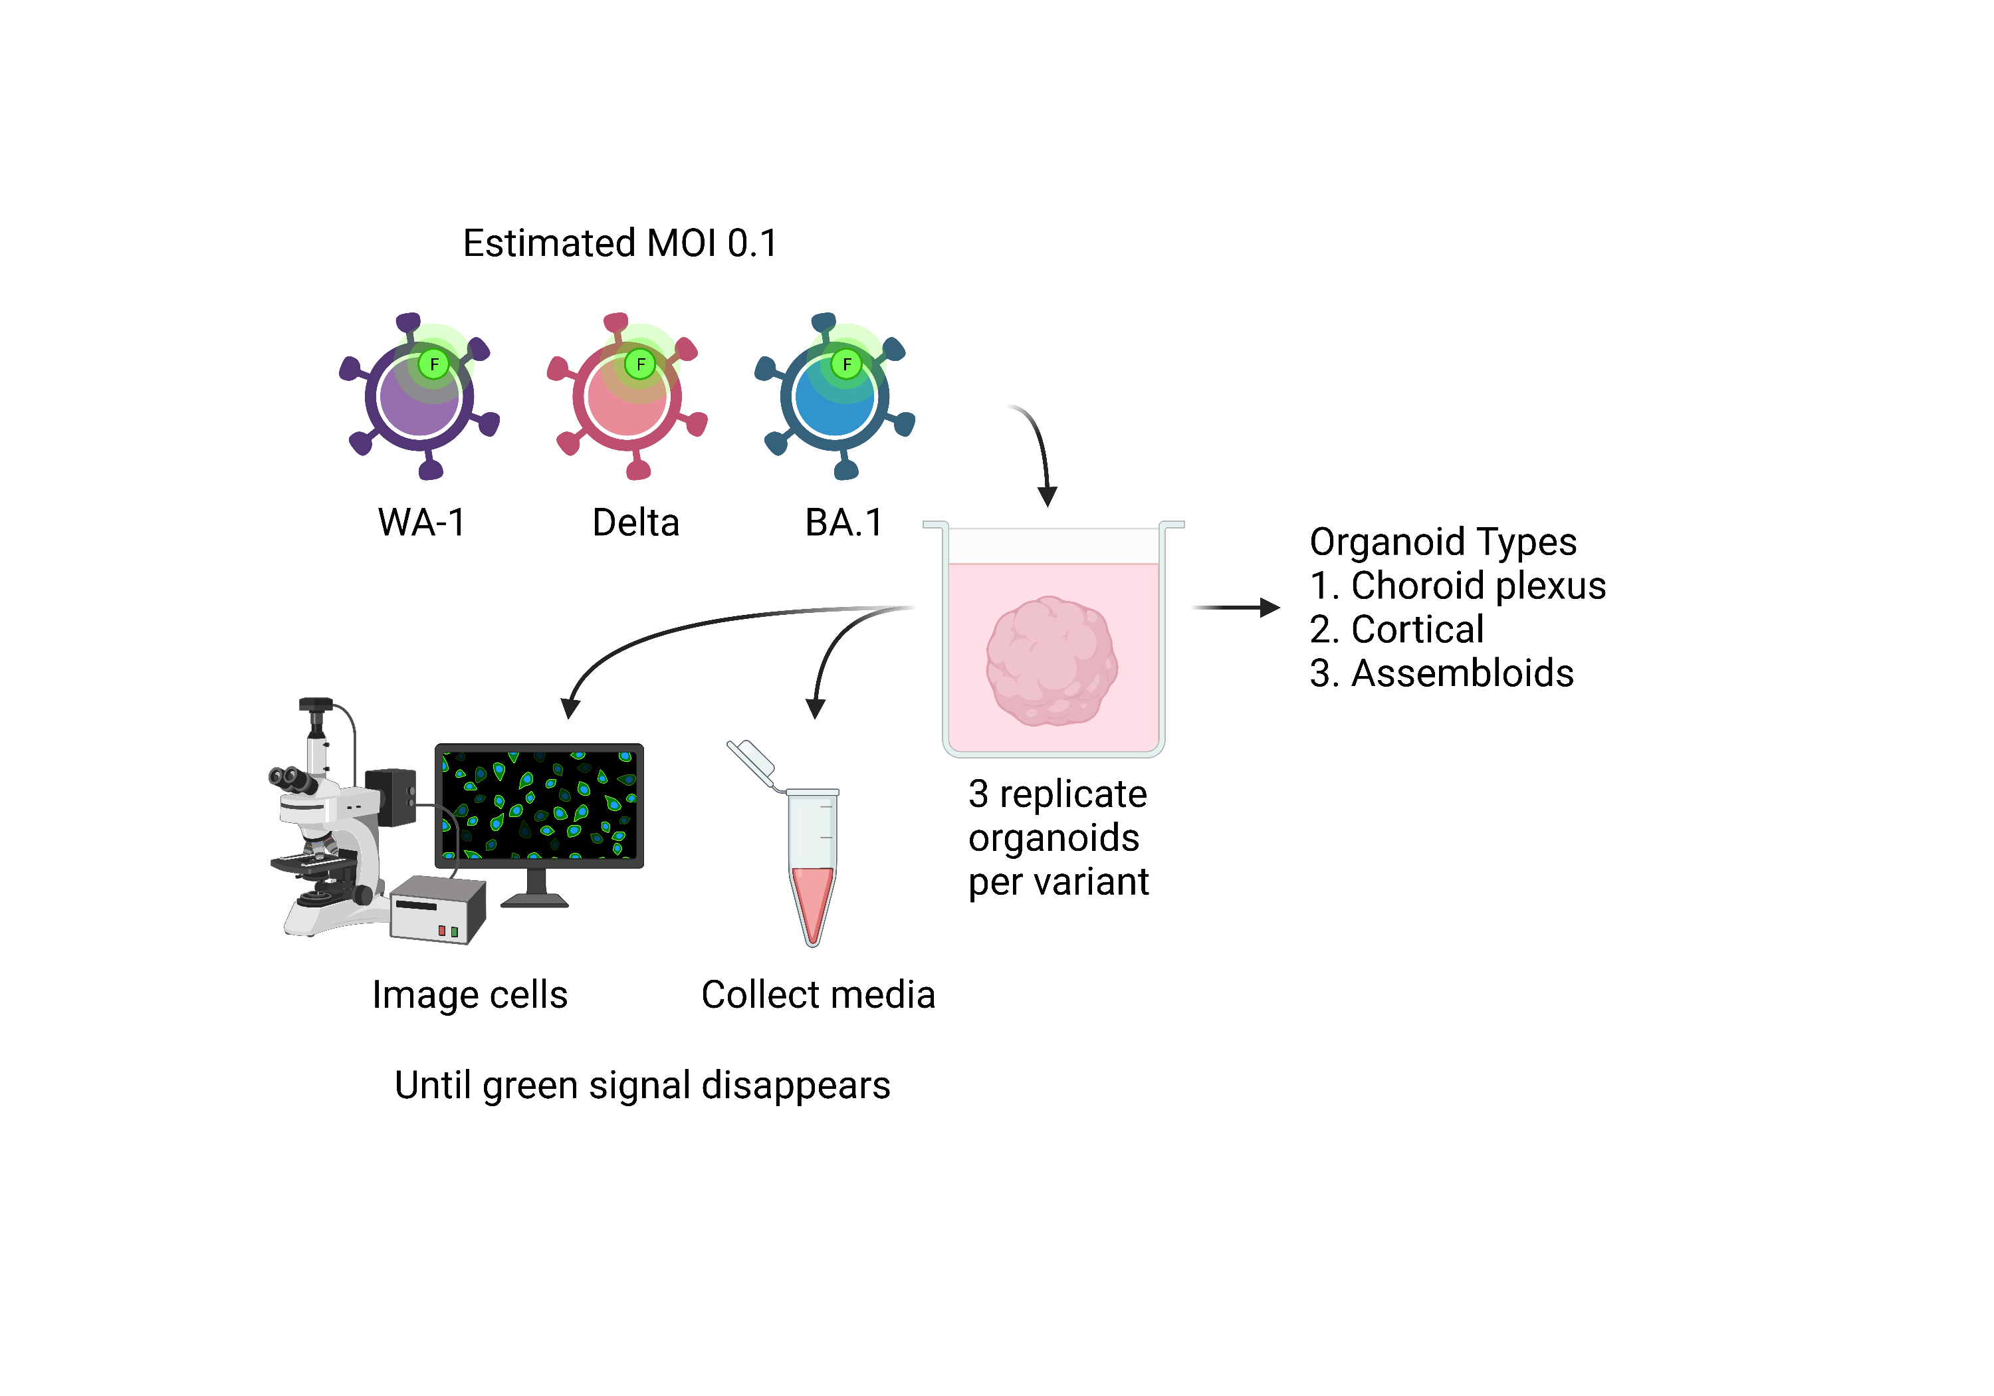
A
C
B
A. Difference in infectivity for variants
B. Persistence of virus and inflammation
C. Changes in brain cell expression profile

Slide 27
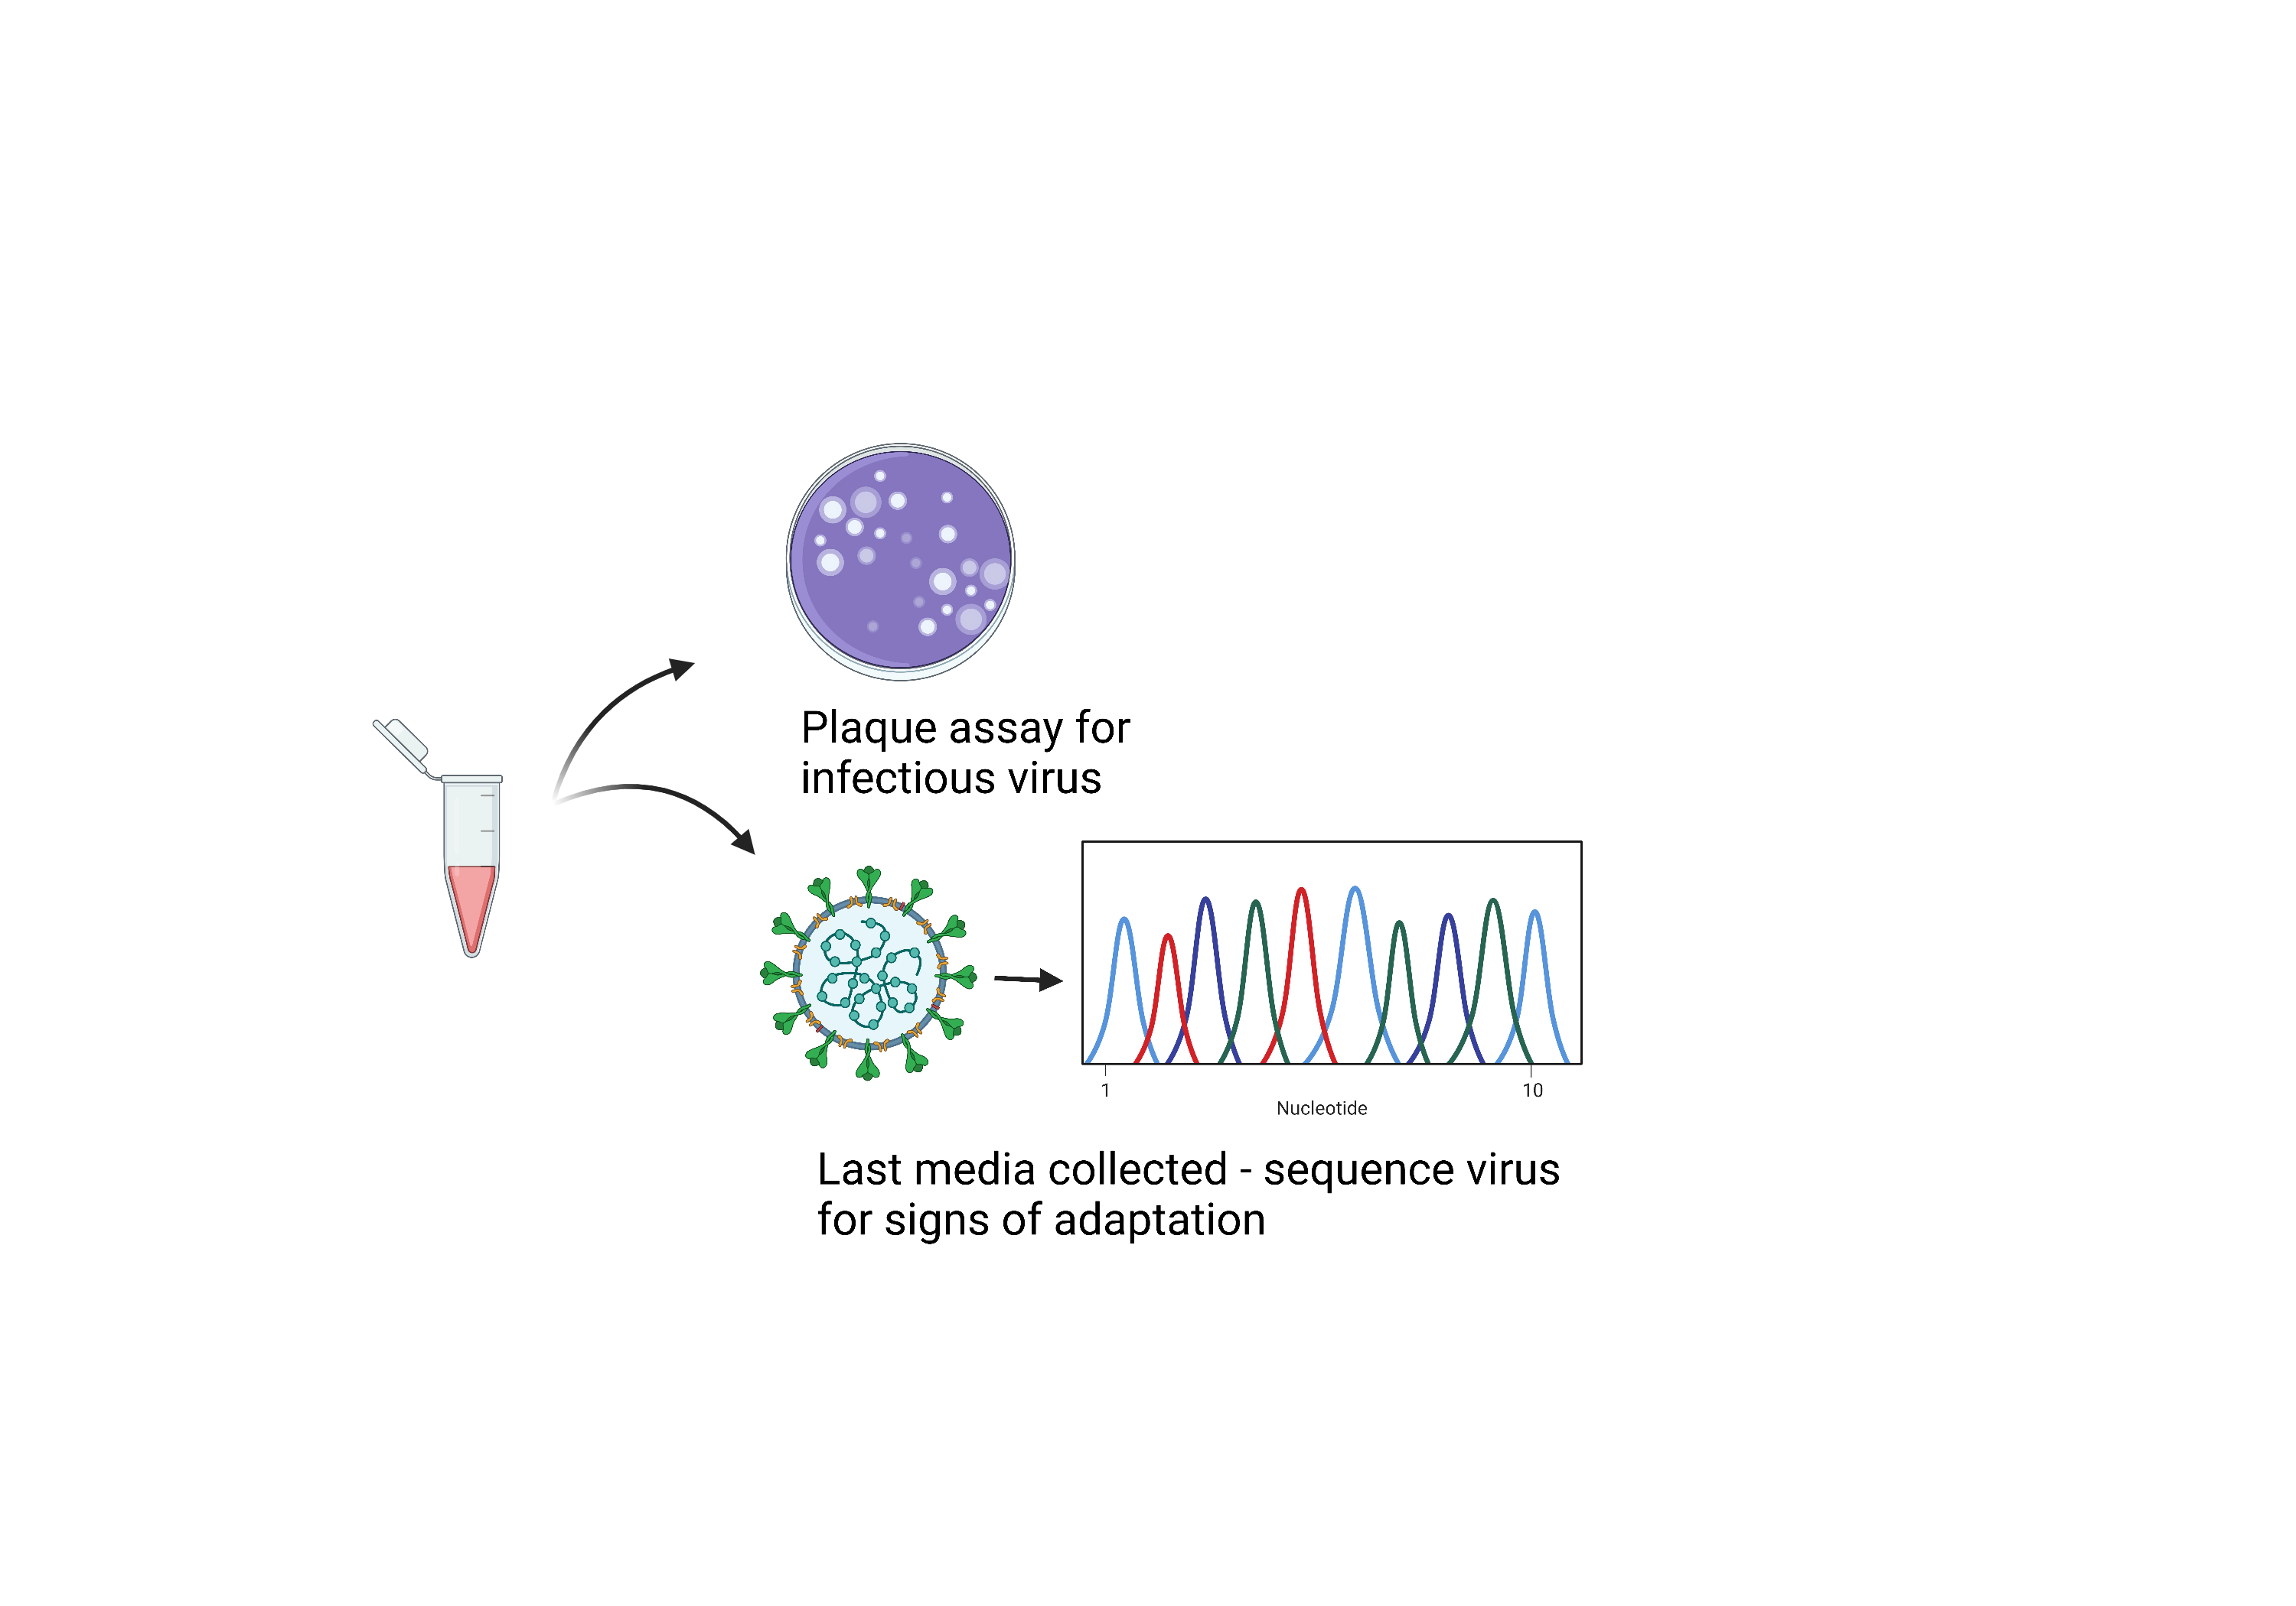
D
D. Viral adaptation to infection of brain cells

Slide 28
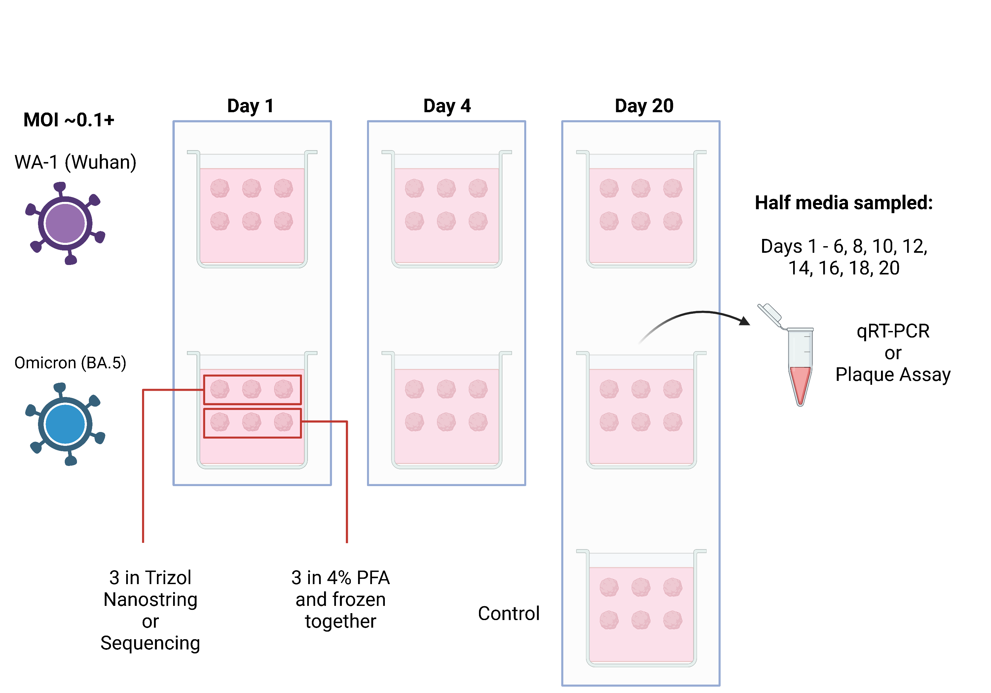
FINDINGS?
Notes:
Format for experiments given 40-50 organoids

Slide 29
How is this translational?
A. Difference in infectivity for variants | Incidence of Neuro or Long COVID
B. Persistence of virus and inflammation | Antivirals vs immuno-modulatory drugs
C. Changes in brain cell expression profile | Specific pathways
D. Viral adaptation to infection of brain cells | Possibility of increased virulence

Slide 30
Summary

Slide 31
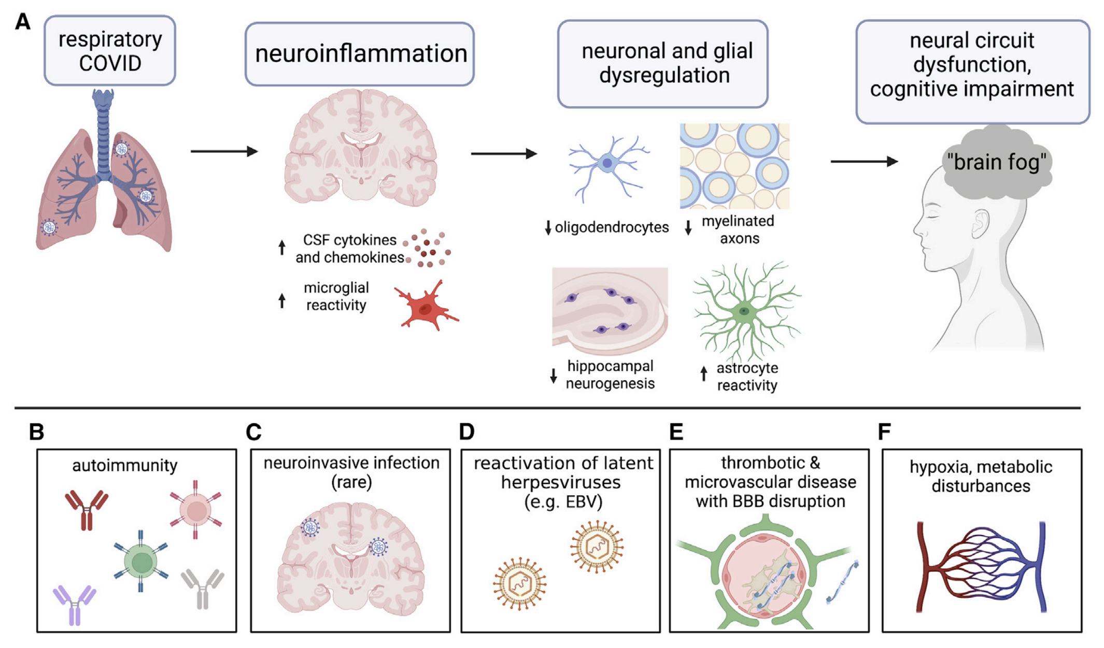
The neurobiology of long COVID. Monje and Iwasaki 2022

Slide 32
Viruses in the CNS have a disease burden much greater than just severe acute illness
Prevailing hypotheses of Long COVID involve multiple organ systems and defects
Organoids are powerful and complement other tools
The immune system is heavily involved in brain disease and homeostasis – Long COVID is no exception

Slide 33



John Yun-Chung Chen
Cody Bills
Karl Valerdi
Ky Trinh
Dr. Pei-Yong Shi Lab
Dr. Xuping Xie
Dr. Jing Zou
Dr. Hongjie Xie
Dr. Chaitanya Kurhade
Dr. Birte Kalveram
Dr. Yan Wang
Dr. Long Sun
Dr. Yanping Hu
Dr. Hongjun Song Lab
Dr. Zhijian Zhang
Dr. Guo-li Ming Lab
MD/PhD Program
Dr. Michael Laposata

Slide 35
United Kingdom
Long COVID symptoms adversely affected the day-to-day activities of 1.4 million people (72% of those with self-reported long COVID), with 409,000 (21%) reporting that their ability to undertake their day-to-day activities had been "limited a lot".
Fatigue continued to be the most common symptom reported as part of individuals' experience of long COVID (56% of those with self-reported long COVID), followed by shortness of breath (31%), loss of smell (22%), and muscle ache (21%).
As a proportion of the UK population, the prevalence of self-reported long COVID was greatest in people aged 35 to 69 years, females, people living in more deprived areas, those working in social care, health care, or teaching and education, and those with another activity-limiting health condition or disability.
The estimates presented in this analysis relate to self-reported long COVID, as experienced by study participants who responded to a representative survey, rather than clinically diagnosed ongoing symptomatic COVID-19 or post-COVID-19 syndrome in the full population.

Slide 36
United Kingdom
An estimated 2.0 million people living in private households in the UK (3.0% of the population) were experiencing self-reported long COVID (symptoms continuing for more than four weeks after the first suspected coronavirus (COVID-19) infection that were not explained by something else) as of 4 June 2022 (see Figure 1).
Of people with self-reported long COVID, 405,000 (21%) first had (or suspected they had) COVID-19 less than 12 weeks previously, 1.4 million people (74%) at least 12 weeks previously, 807,000 (41%) at least one year previously and 403,000 (21%) at least two years previously.
Of people with self-reported long COVID, 570,000 (29%) first had (or suspected they had) COVID-19 before Alpha became the main variant; this figure was 237,000 (12%) in the Alpha period, 394,000 (20%) in the Delta period, and 642,000 (33%) in the Omicron period.

Slide 37
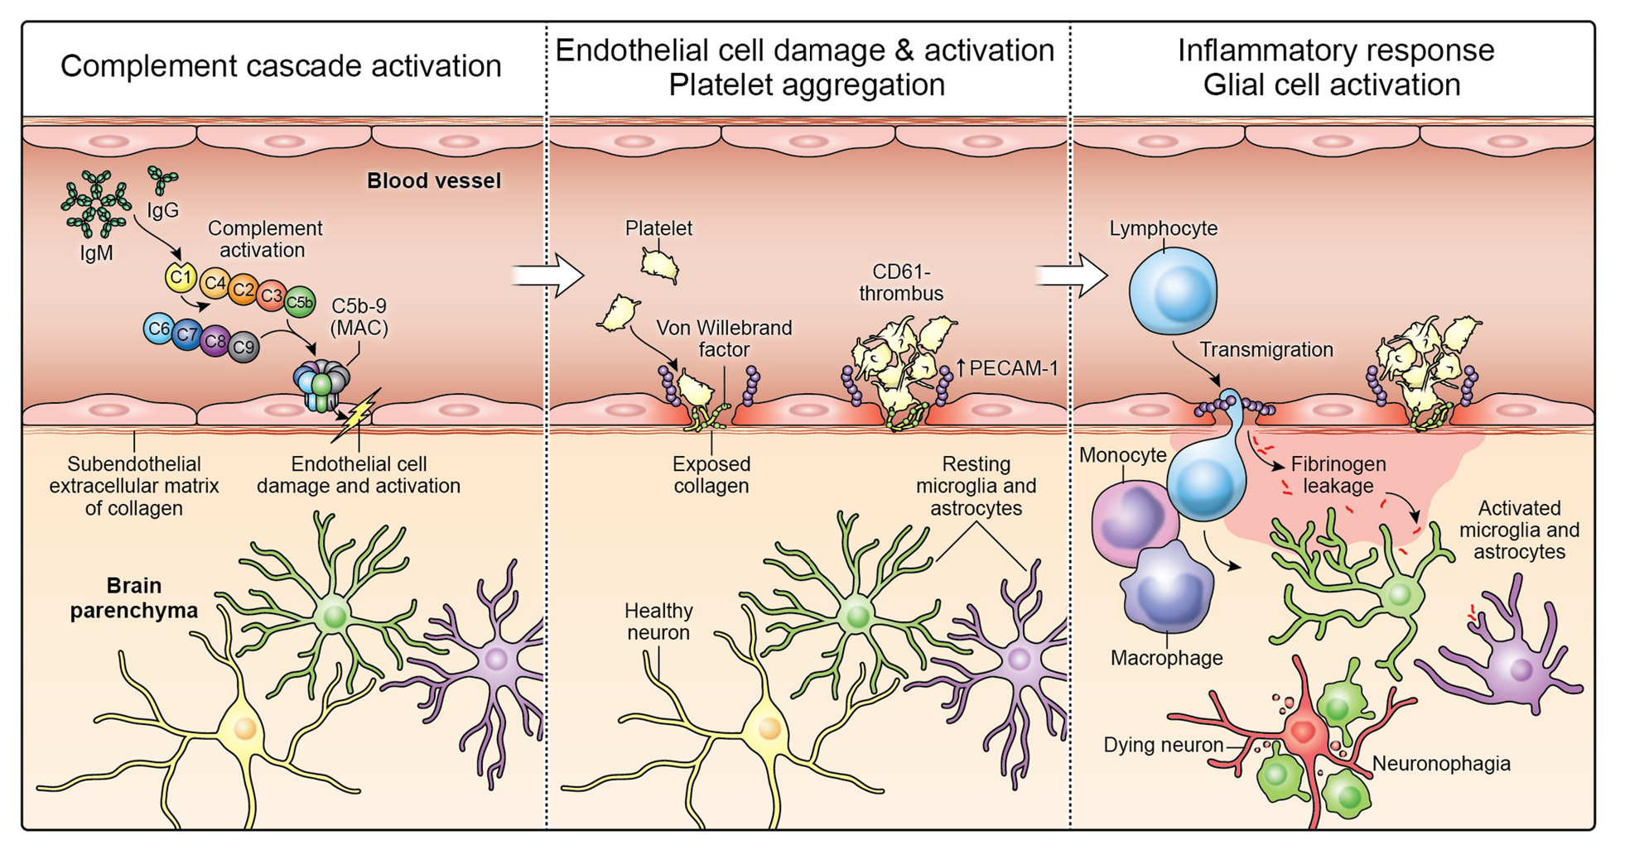

Slide 38
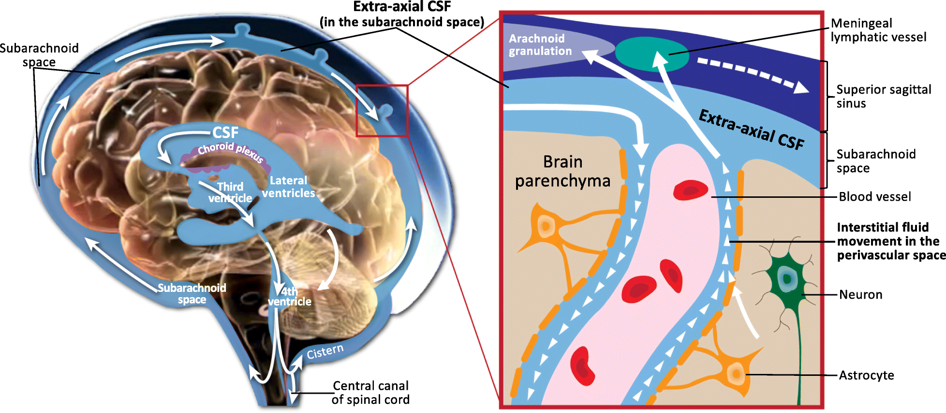

Slide 39
NeuroCOVID
 | No. (%)
 | Total (N = 214) | Severe (n = 88) | Non-severe (n = 126)
Any Nervous System Symptoms | 78 (36.4) | 40 (45.5) | 38 (30.2)
CNS | 53 (24.8) | 27 (30.7) | 26 (20.6)
Dizziness | 36 (16.8) | 17 (19.3) | 19 (15.1)
Headache | 28 (13.1) | 15 (17.0) | 13 (10.3)
Impaired consciousness | 16 (7.5) | 13 (14.8) | 3 (2.4)
Acute cerebrovascular disease | 6 (2.8) | 5 (5.7) | 1 (0.8)
Ataxia | 1 (0.5) | 1 (1.1) | 0
Seizure | 1 (0.5) | 1 (1.1) | 0
Notes:
Early on in the pandemic, potential for brain involvement was identified in Wuhan. Past outbreaks with beta coronaviruses indicated that neurologic consequences might be possible with SARS-CoV-2 as well.
This spawned the medical entity known as NeuroCOVID with symptoms such as those listed here in this table.

